Slide 1

Welcome To Our Presentation
On
“ FACIAL RECOGNITIONS ”

Slide 2

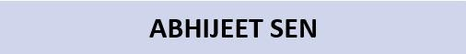

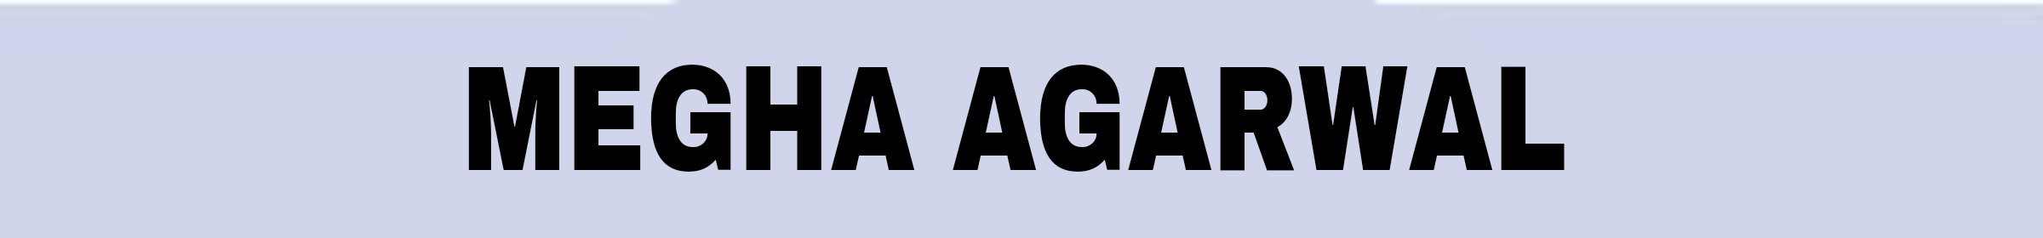
Presented By:-

Slide 3

Guided By:-
SOUVIK MONDAL
Hyland India Hackathon 2022

Slide 4
CONTENTS
AIM
1
SOFTWARE DESIGN AND IMPLEMENTATION
4
INTRODUCTION
2
FUTURE SCOPE WITH ADVANTAGE
5
STEP BY STEP PLANNING AND EXECUTION
3
CONCLUSION
6

Slide 5


ABSTRACT
STEP
STEP
01
04
Face Recognition is a computer application that is capable of detecting,
tracking, identifying or verifying human faces from an image or video
captured using a digital camera.
Our Aim is practically implemented in real-life environment as an
automatic attendance management system.
STEP
STEP
02
05
STEP
STEP
03
06

Slide 6
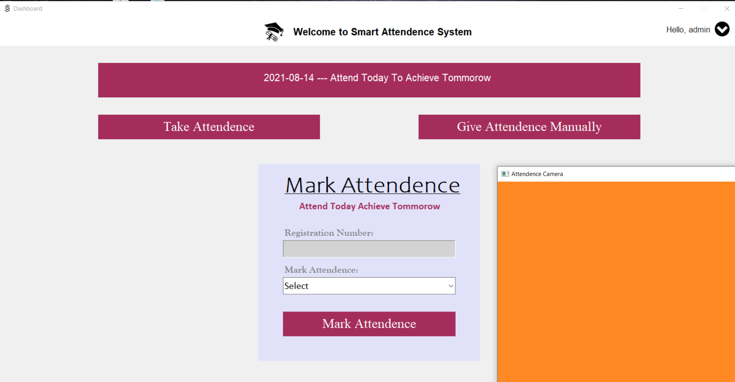
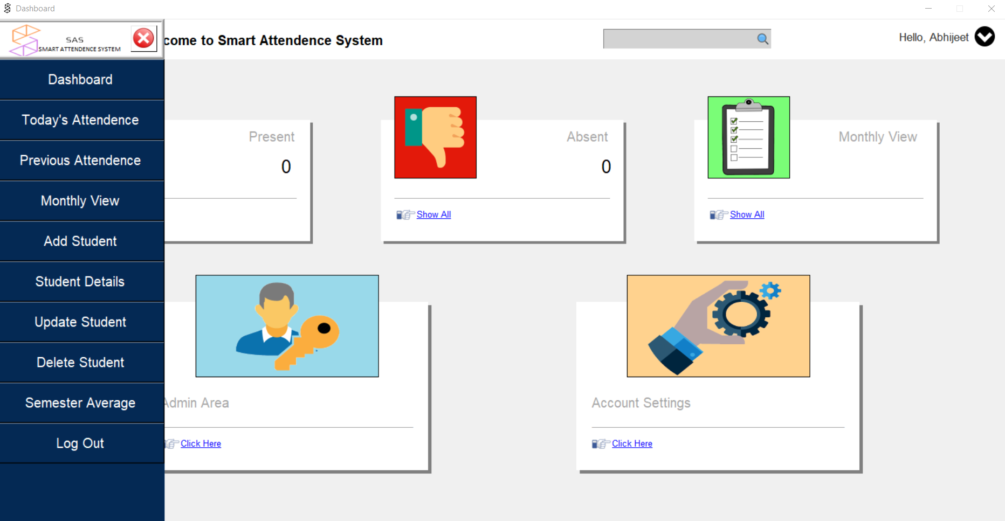
INTRODUCTION
STEP
STEP
01
04
In every sphere, technological advancements are taking place to match the pace of growing
business. One such system that makes the process of attendance and admission instant is the facial
recognition attendance system.
It is straightforward to identify any person from different facial images. This biometric is very safe
because it can identify people without any mistakes.
STEP
STEP
02
05
This system is used in many government offices, firms, banks, and other places. In this project, the
Open CV based face recognition approach has been proposed.
.
STEP
STEP
03
06

Slide 7







STEP BY STEP PLANNING AND EXECUTION
STEP
Grabbing The Success
06
Result Checking And
Testing
STEP
05
Setting Task
And
Scheduling Meets Every Weekends
STEP
04
Defining Roles And Responsibility
STEP
03
STEP
Project Budget And Risks
02
What Project We Are Going To Take
STEP
01

Slide 8
SOFTWARE DESIGN AND IMPLEMENTATION
As we developed software which involves two modules in it, i.e. Face Recognition and Attendance Management Module, our first step to design a software was to follow this list down objectives
Our Objectives to design our software :
Correctness
Completeness
Flexibility
Accuracy
More Efficient
Minimal Physical work
Less time consumption
Cost Efficient

Slide 9

SCREENSHOTS RELATED TO OUR SOFTWARE DESIGNING

Slide 10

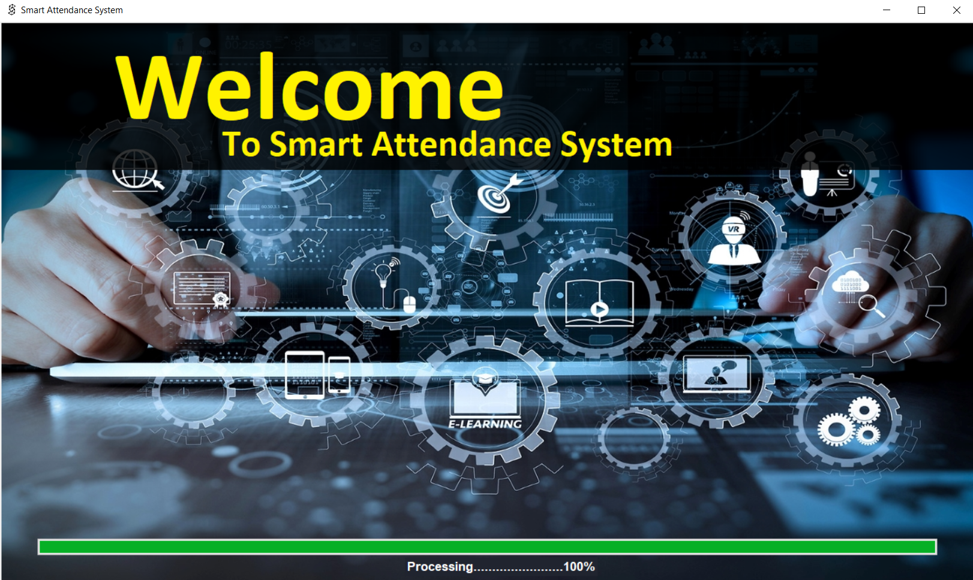
First page

Slide 11
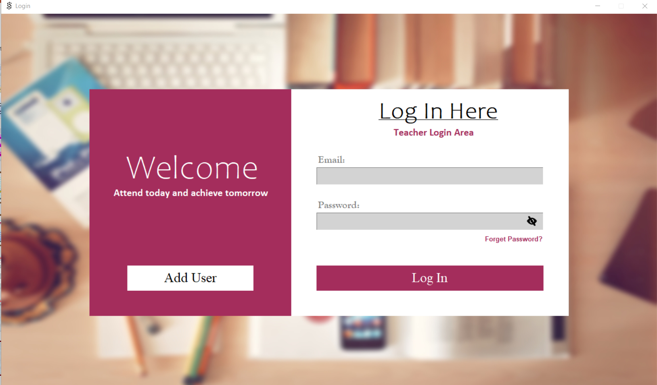
Login Page

Slide 12
Dashboard Page

Slide 13
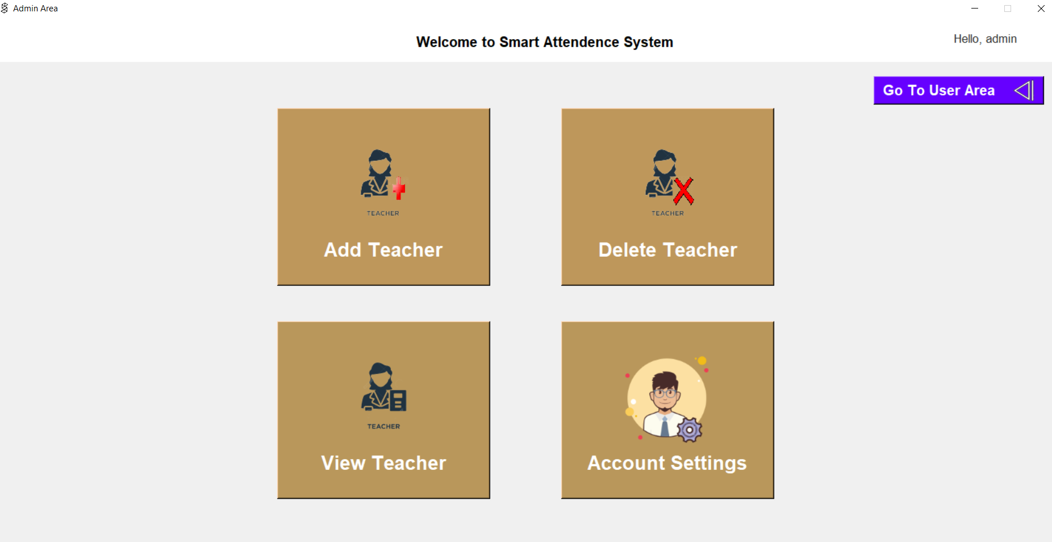
Admin Page

Slide 14
Face recognition module

Slide 15
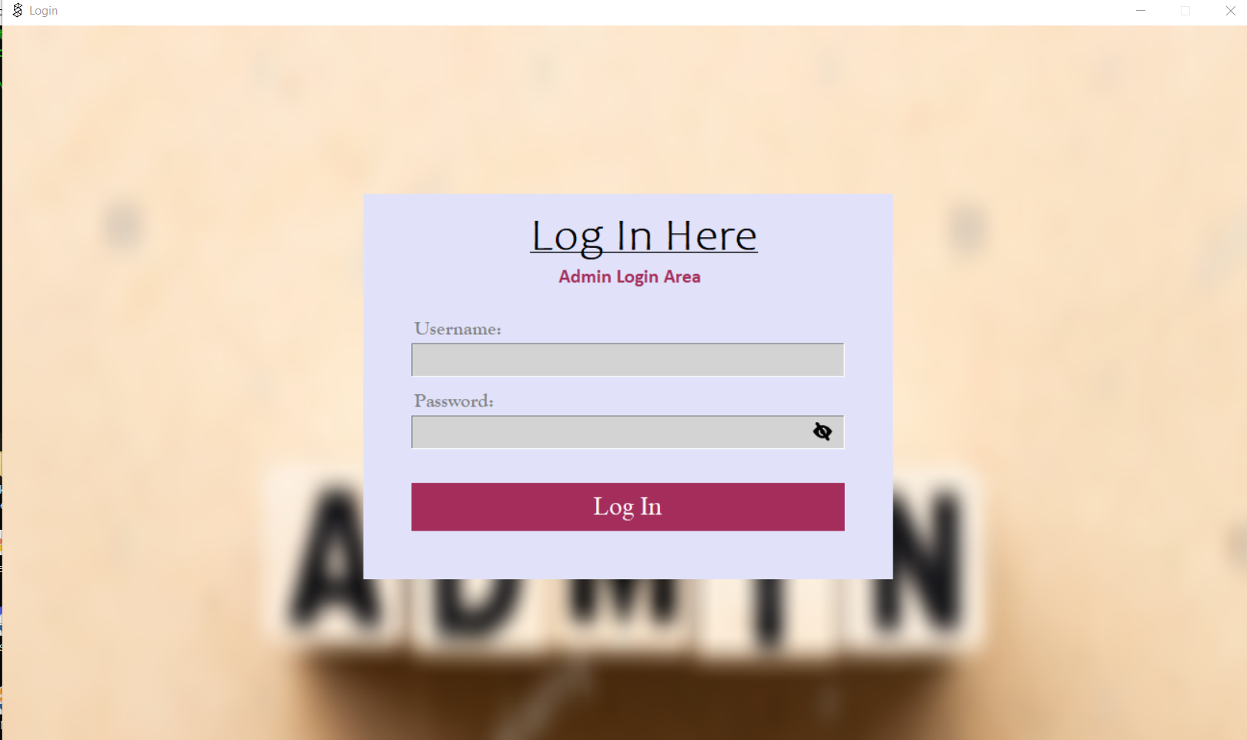
Login Page

Slide 16
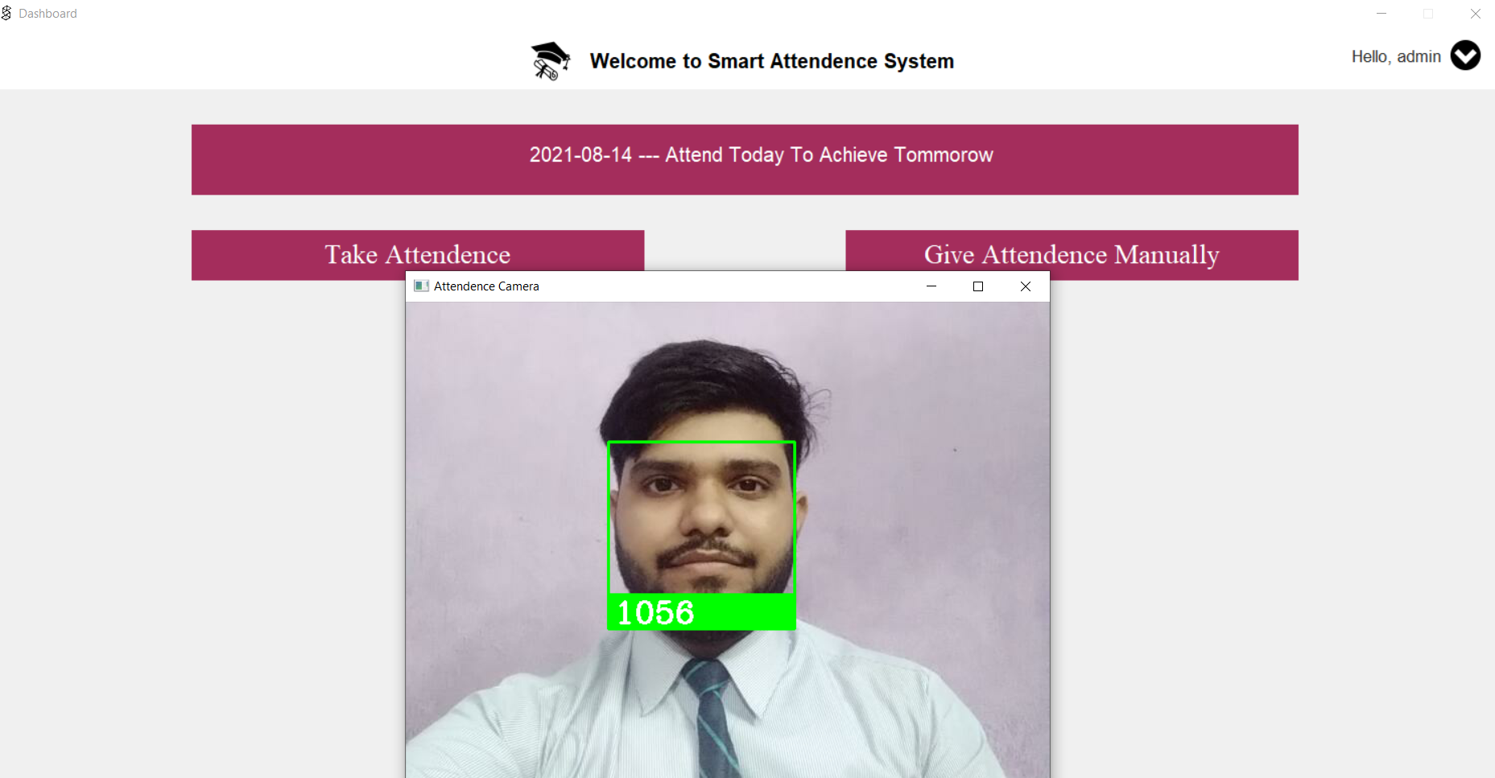
Taking Attendance Through Face Recognition

Slide 17
Conclusion with Future Scope
Smart attendance management system is designed to solve the issues of existing
manual systems. We have used face recognition concept to mark the attendance of
student and make the system better. In future this system need be improved
because these system sometimes fails to recognize students from some distance,
also we have some processing limitation, working with a system of high processing
may result even better performance of this system.
Future Scope
SURVIALANCE
TRACKING PURPOSE
ATTENDANCE MANGEMENT OF VARIOUS ORGANISATION LIKE SCHOOLS,CORPORATE OFFICES, EDUCATIONAL INSTITUITIONS, HOSPITALS ETC.
Conclusion with
Future Scope

